Slide 1

House Prices Prediction
Data Mining| GW School of Business| Zhencun Liu, Xinran Tao, Xin Su, Ziyi Zhao

Slide 2
Overview
Data Exploration
Data Processing
Modeling
Results
Data Processing
Correlation
Outlier
Skewness
Auto Machine Learning
Results
Variable Types
Missing Value
Feature Engineering
Data Exploration
Modeling

Slide 3
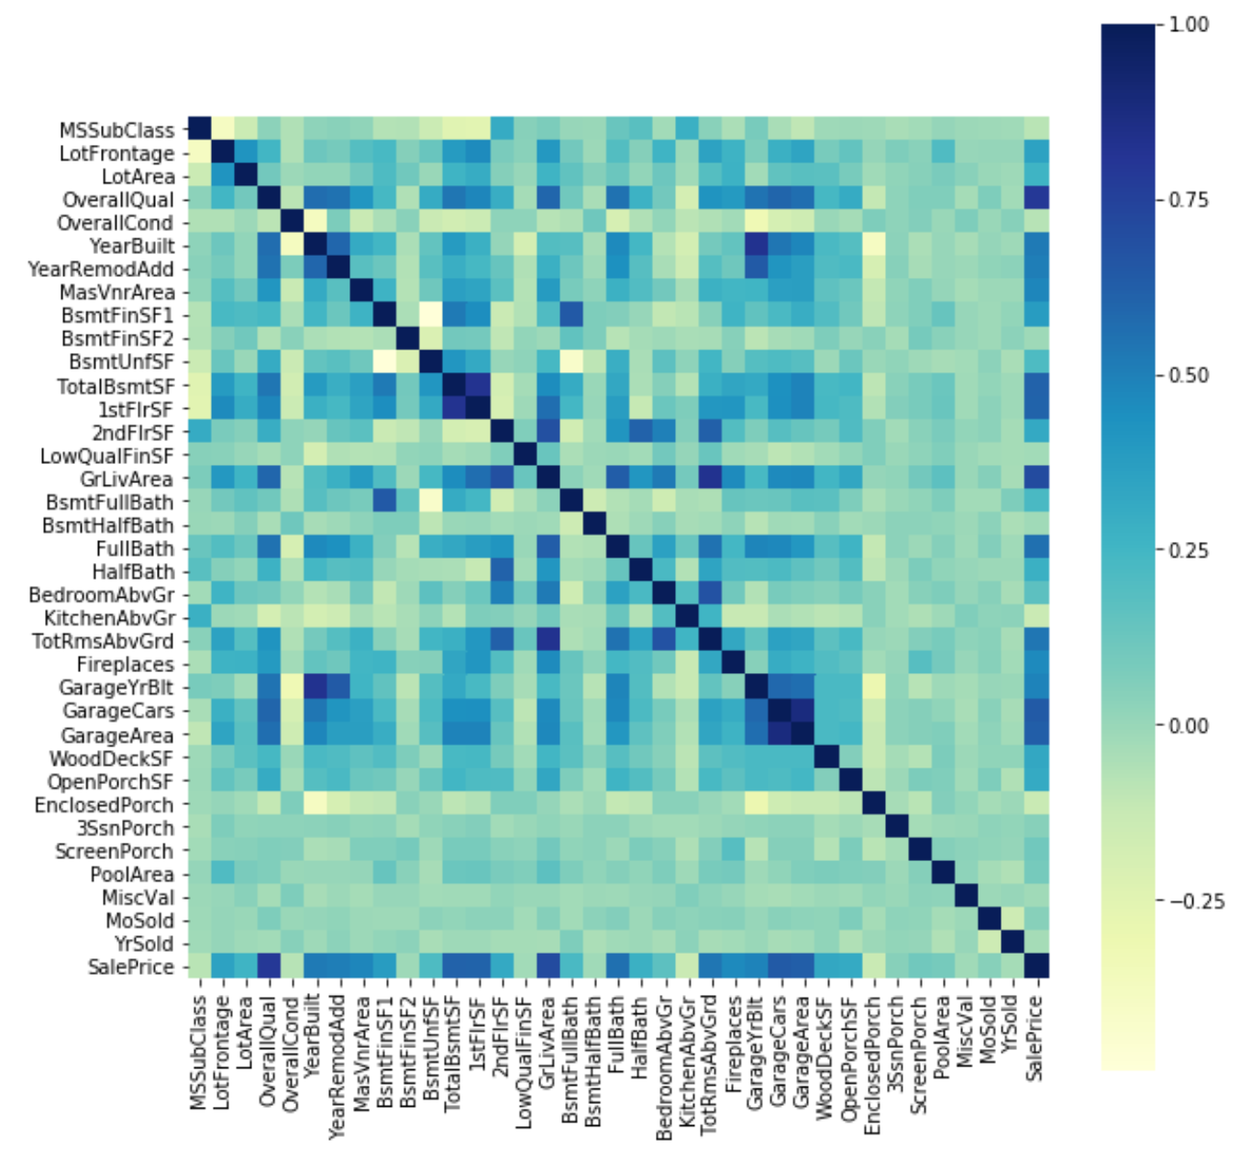
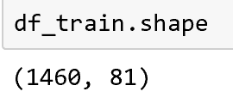
Overview
Data Exploration
Data Processing
Modeling
Results
Notes:
Xin Su

Slide 4
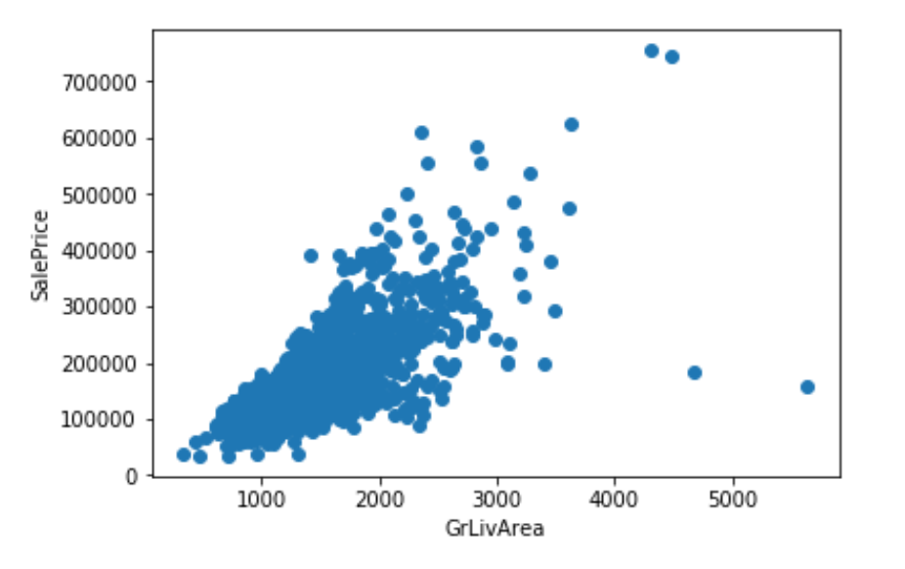
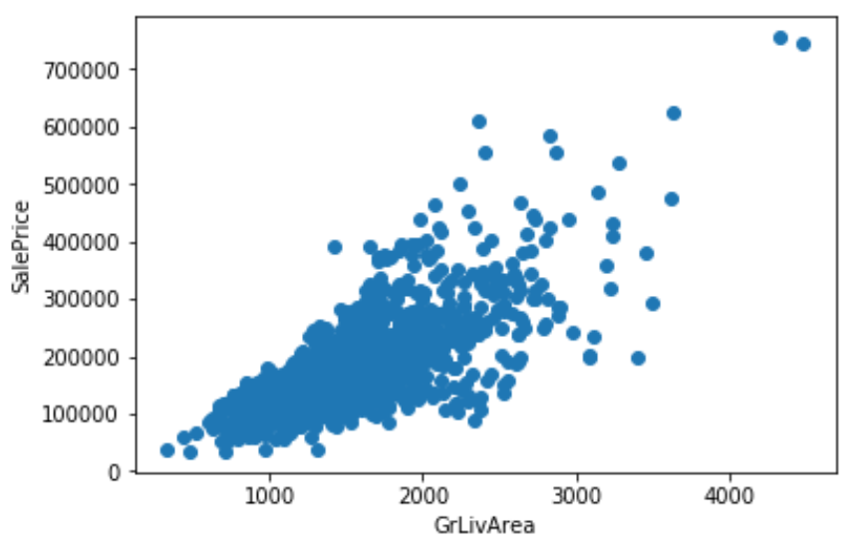
Overview
Data Exploration
Data Processing
Modeling
Results
Notes:
Xin Su

Slide 5
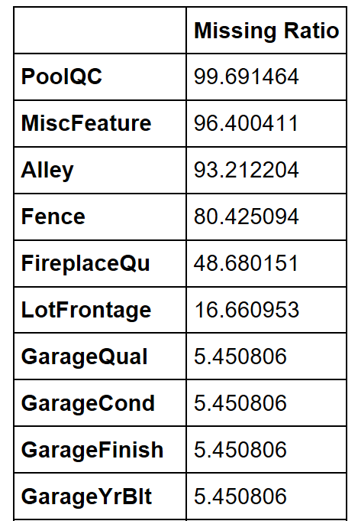
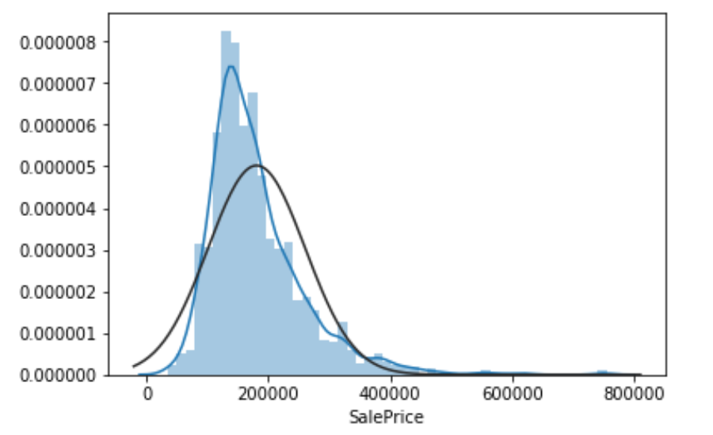
Overview
Data Exploration
Data Processing
Modeling
Results
Notes:
Xin Su

Slide 6
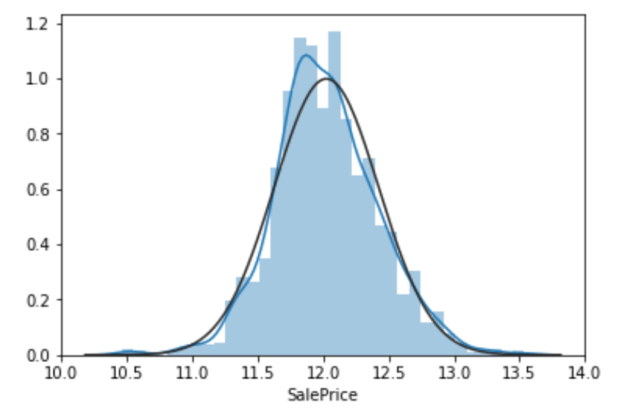
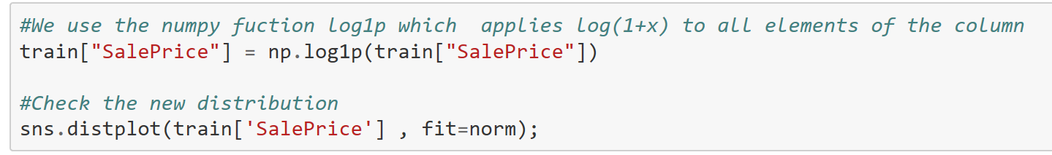
Overview
Data Exploration
Data Processing
Modeling
Results

Slide 7
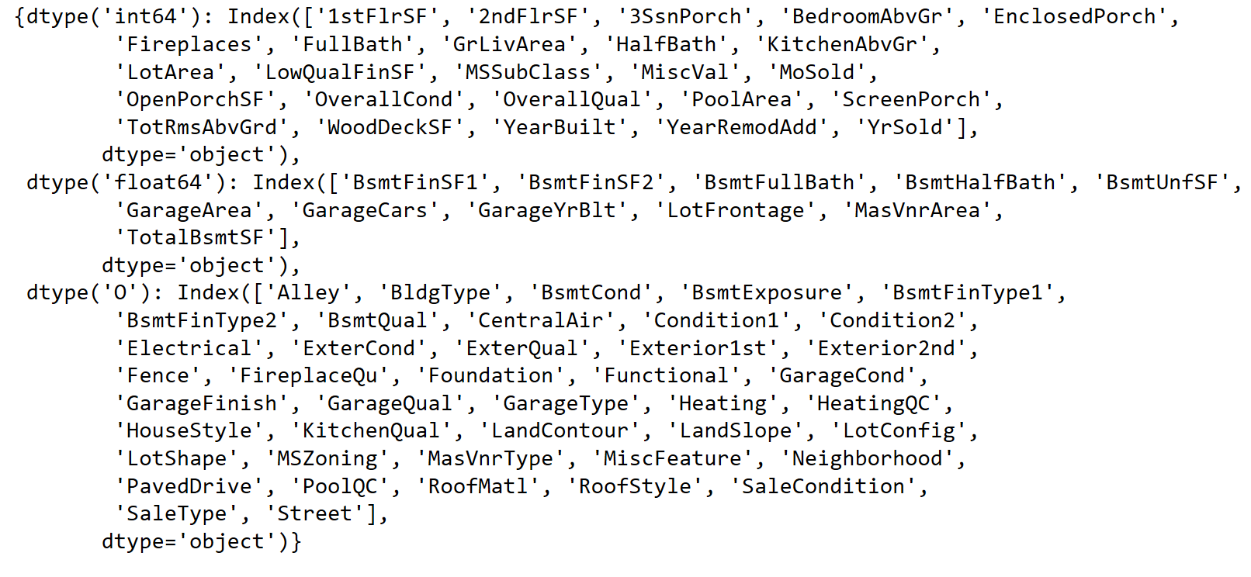
Overview
Data Exploration
Data Processing
Modeling
Results
Nominal
Ordinal

Slide 8
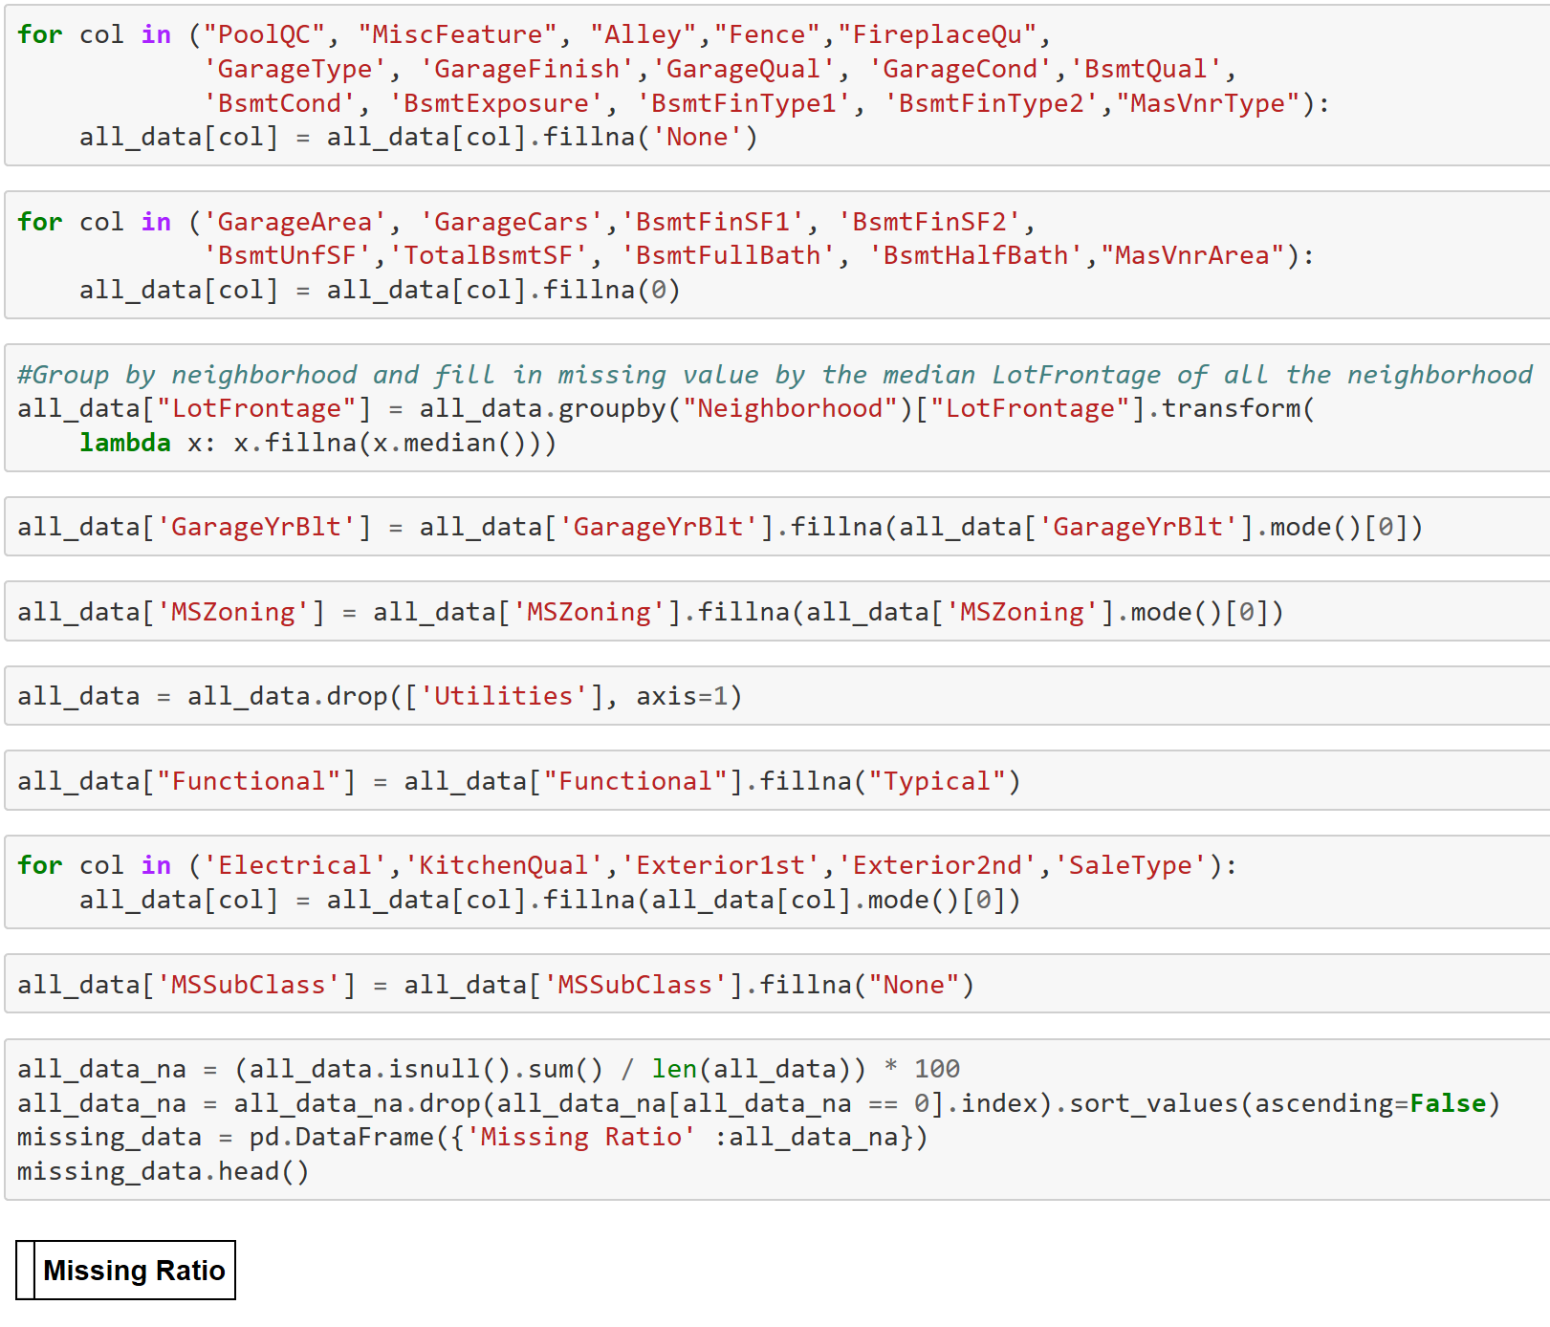
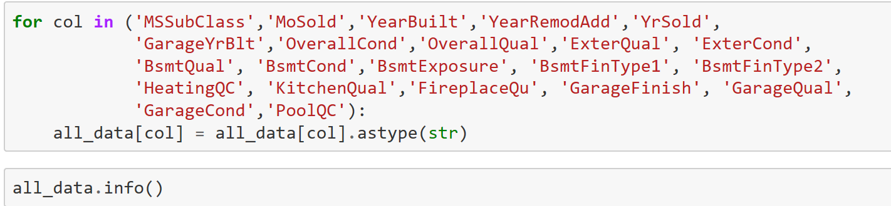
Overview
Data Exploration
Data Processing
Modeling
Results
Float (10), Integer (18), Object (51)

Slide 9
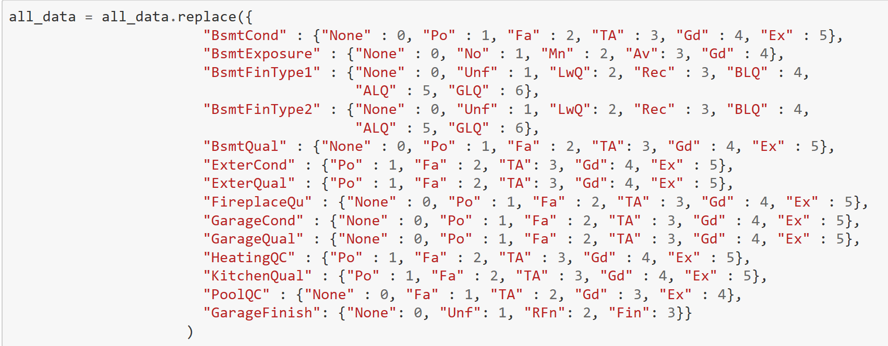
Overview
Data Exploration
Data Processing
Modeling
Results
Categorical Variables

Slide 10
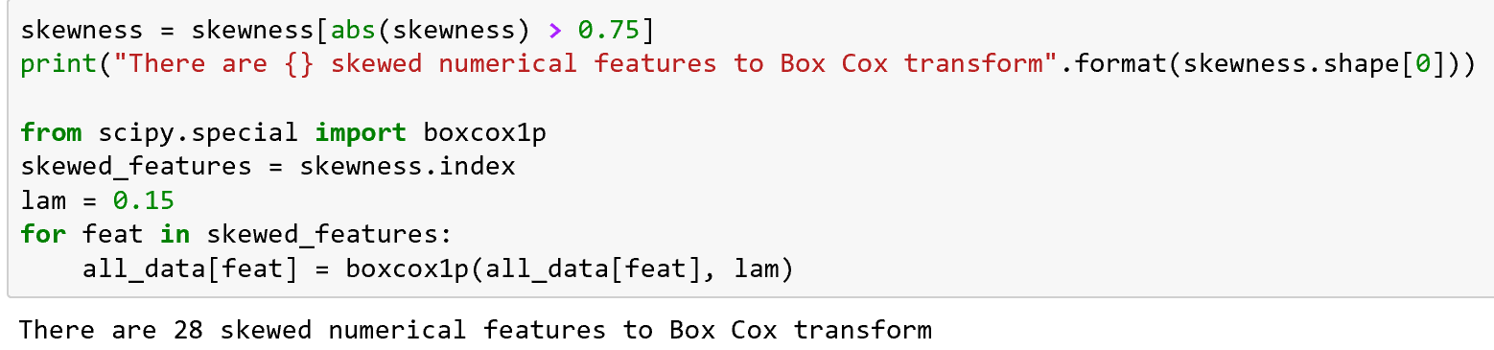
Overview
Data Exploration
Data Processing
Modeling
Results
Numeric Variables

Slide 11
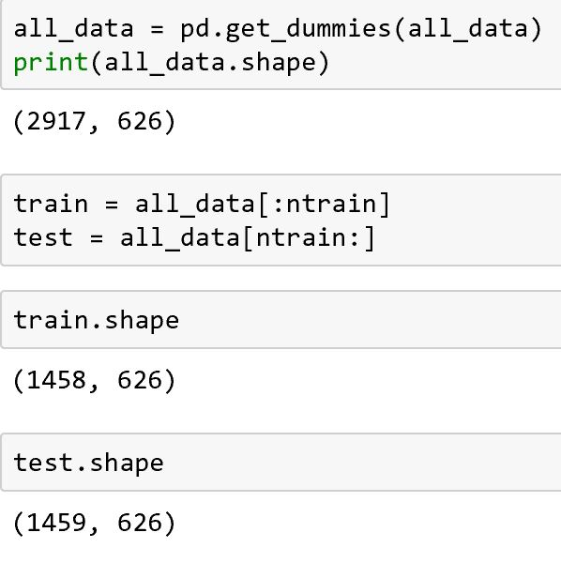
Overview
Data Exploration
Data Processing
Modeling
Results
Get Dummies

Slide 12
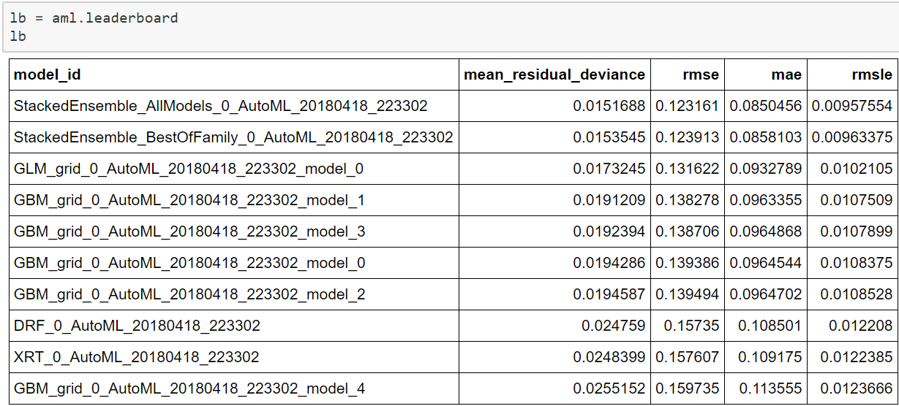


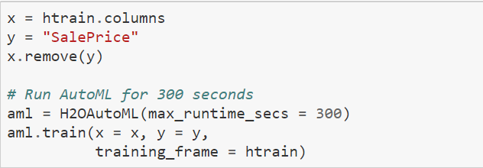
Overview
Data Exploration
Data Processing
Modeling
Results
Notes:
Xinran Tao

Slide 13
Overview
Data Exploration
Data Processing
Modeling
Results
Results
Root Mean Squared Logarithmic Error
Notes:
Xinran Tao

Slide 14
Overview
Data Exploration
Data Processing
Modeling
Results
Reference
https://www.kaggle.com/hamzaben/tuned-random-forest-lasso-and-xgboost-regressors
https://www.kaggle.com/serigne/stacked-regressions-top-4-on-leaderboard
http://onlinestatbook.com/2/transformations/box-cox.html
http://ww2.amstat.org/publications/jse/v19n3/Decock/DataDocumentation.txt
https://www.kaggle.com/c/house-prices-advanced-regression-techniques/data
Notes:
Xinran Tao

